Slide 1
Documents as Digital Data
What is “Digital Engineering” and what does it mean for defense standardization?
Jesse Chambers
Defense Standardization Program Office
3 Aug 2022
Notes:
Good afternoon or good morning – depending on where you are…
My name is Jesse Chambers, an Engineer with the DSPO and I will be briefly discussing our efforts related to documents as digital data.

Slide 2
Agenda
Digital Engineering and the Digital Transformation
Documents as Digital Data
XML Conversion and Way Ahead
Notes:
I will start with some background on the U.S. DoD’s digital transformation and specifically digital engineering efforts – the “why” behind our efforts at DSPO.
Then Jesse will go a bit deeper into the “what” we are doing; specifically regarding conversion of documents into XML.

Slide 3
Agenda
Digital Engineering and the Digital Transformation
Documents as Digital Data
XML Conversion and Way Ahead
Notes:
In today’s presentation we will focus on efforts aligned with Digital Engineering and Standards management, though
there are also implications for digital transformation within the DoD CIO and Acquisition and Sustainment organizations

Slide 4
Digital Terms and Initiatives
Digital engineering: An integrated digital approach that uses authoritative sources of systems' data and models as a continuum across disciplines to support life cycle activities from concept through disposal..
- DAU Glossary
“MBSE [Model Based Systems Engineering] is the formalized application of modeling to support system requirements, design, analysis, verification, and validation activities beginning in the conceptual design phase and continuing throughout development and later life cycle phases.”
-- International Council on Systems Engineering (INCOSE),
Systems Engineering Vision 2020, Sep 2007
Digital thread: An extensible, configurable, and component enterprise-level analytical framework that seamlessly expedites the controlled interplay of authoritative technical data, software, information, and knowledge in the enterprise data-information-knowledge systems, based on the Digital System Model template, to inform decision makers throughout a system's life cycle by providing the capability to access, integrate, and transform disparate data into actionable information.
- DAU Glossary
Digital transformation (DX) is the adoption of digital technology by a company to improve business processes, value for customers and innovation.
- Wikipedia
Digital twin: An integrated multiphysics, multiscale, probabilistic simulation of an as-built system, enabled by Digital Thread, that uses the best available models, sensor information, and input data to mirror and predict activities/performance over the life of its corresponding physical twin.
- DAU Glossary
…and, a catch-all “MBX”, where “X” is fill in the blank:
  Logistics
  Manufacturing
  Definition, Design, Engineering, etc…
Notes:
Before I go any further, we should define some of the terms. The terms listed here are not comprehensive, but a few are necessary to understand before moving further…
I’m sure there are other sources of definitions for some of the terms. Those listed as DAU Glossary definitions are the official DoD definitions though you will see that even in the DoD there are some slight differences in how Digital Engineering is viewed depending on the perspective of the organization and individual.
For this presentation, we will focus on Digital Engineering and Digital Transformation as the context for documents as digital data…
Digital Transformation (DX)- is the adoption of digital technology and processes.
Digital Engineering (DE)- is an integrated digital approach using authoritative sources of systems’ data and models as a continuum across disciplines and across the system life cycle.
Another important and related term that is not listed here is Technical Coherence: The logical traceability of the evolution of a system's data and models, decisions, and solutions throughout the life cycle. (DAU Glossary)
I mention this term because standards could/should play a significant role in establishing that logical traceability and the interoperability necessary between systems’ data and models.
Think of digital transformation as the shift from paper-based to digital data and/or model-based products, processes, and practices. And, Digital Engineering as simply the desired endstate of digital transformation for engineering products, processes, and practices.

Slide 5
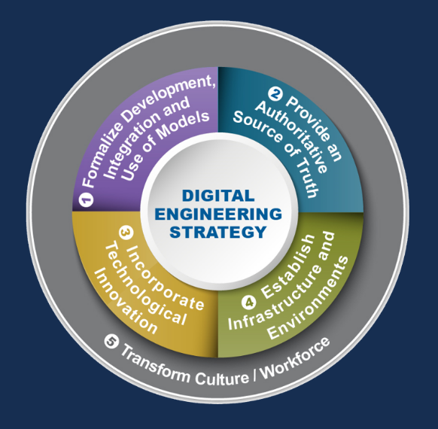
Digital Engineering Strategy (June 2018)
Outlines five elements necessary for the DE ecosystem to thrive:
Formalize the development, integration, and use of models to inform enterprise and program decision making.
Provide an enduring, authoritative source of truth.
Incorporate technological innovation to improve the engineering practice.
Establish a supporting infrastructure and environments to perform activities, collaborate, and communicate across stakeholders.
Transform the culture and workforce to adopt and support digital engineering across the lifecycle
Notes:
In order to define and realize that digital endstate, the DoD published the Digital Engineering Strategy which established five goals or “elements” for successful DE…
As depicted in the graphic, the elements are all interrelated:
The Concept of an Authoritative Source of Truth (ASoT) (element 2) is key to realizing the digital transformation through integration of data and models (element 1). But this concept is more complex than just identifying one single source…it allows for
Linking multiple sources of data
From different viewpoints (design, manufacturing, sustainment…)- models used to store, link, analyze, and provide different simplified viewpoints for human use
Of the same system, and of interrelated systems (i.e., SoS concept)
And doing so over the life-cycle of the system- from design through disposal
Elements 3 and 4 are about using modern technologies to design, engineer, build, field and sustain smarter,
and in order to achieve that, the DoD and defense industry requires an ecosystem to support it- an ecosystem comprised of infrastructure, tools, data, knowledge and other resources. Technologies such as: big data & data analytics and visualization, machine learning, cloud computing, 3D printing, digital manufacturing, and digital twin- are all enablers of digital engineering and the desired ecosystem.
Finally, element 5 addresses the cultural change- (a challenge in any transition effort) includes the training, education, and other efforts to develop skills and knowledge amongst the workforce and change the culture to accept and trust digital products.

Slide 6
Agenda
Digital Engineering and the Digital Transformation
Documents as Digital Data
XML Conversion and Way Ahead
Notes:
Just as Digital Engineering is not an end in itself, documents as digital data is also an enabler, a means to an end
For digital engineering, “docs as digital data” is an enabler to an enabler…
For those who develop and maintain standards, documents as digital data has other, more direct benefits
Our job at DSPO is provide policy, processes, and tools for those that develop, maintain, and use standards.
So, if standards are being developed and used in digital products, processes and tools, then it becomes our responsibility to integrate digital tools and processes and provide standards in a digital form

Slide 7
Transformation of DSP Documents
Notes:
I compare the digital transformation for standards to the transition from printed paper to electronic documents.
----Skip if running late---- We are preparing to celebrate our 70th Anniversary next year.
The DSP has been around for almost 70 years, created in 1952, by Congress in the Cataloging and Standardization Act.
The Act required the creation of a single set of specifications and standards, which DoD buying activities would use in the procurement of similar items.
The Congress believed that a single set of specifications and standards would save money and manpower by avoiding duplication of efforts in document preparation and maintenance
In 1962, the DoD established the DoD Single Stock Point (DoDSSP) to establish a single source for obtaining specifications and standards generated by the DoD.

Slide 8
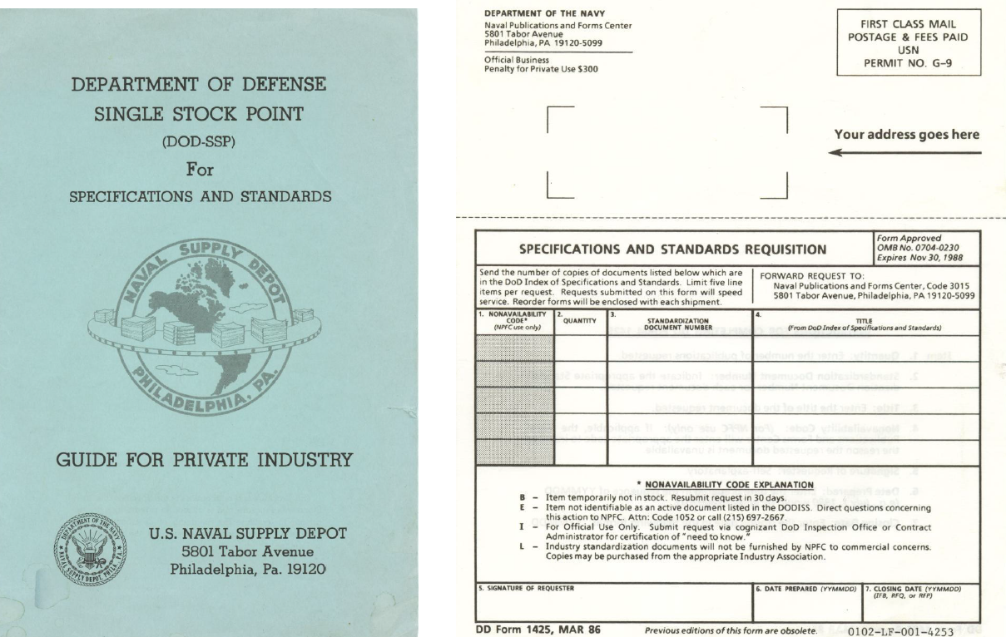
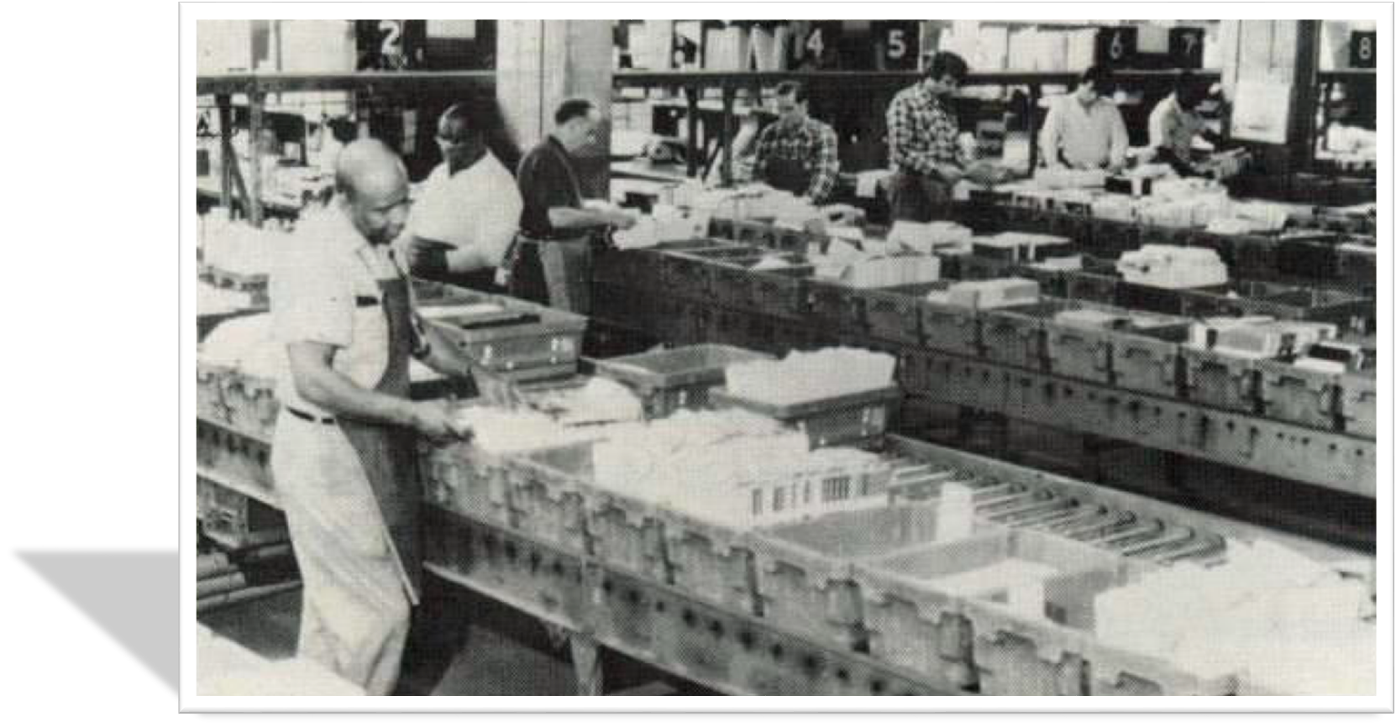
Early Years of the DSP – Printed Paper
Notes:
In the early years, the DoDSSP (Single Stock Point) reduced costs and confusion associated with having multiple points of document distribution within the Military Departments and Defense Agencies.
But it was still very expensive, time consuming and labor intensive…requiring a lot of storage, equipment and manpower.
Among the many limitations of such a manual system, it was not uncommon for documents to be out of stock, which created procurement delays, numerous Congressional complaints, and customer frustration.

Slide 9
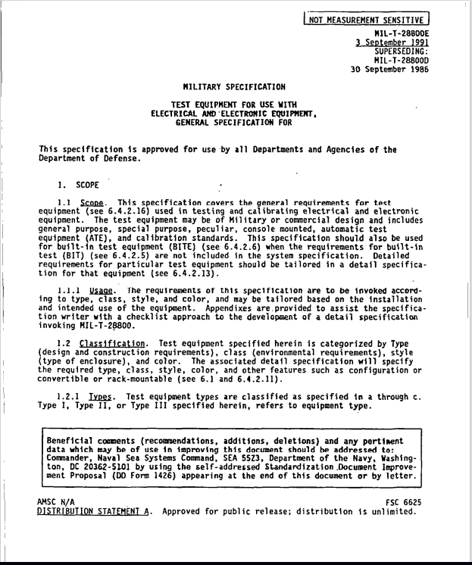
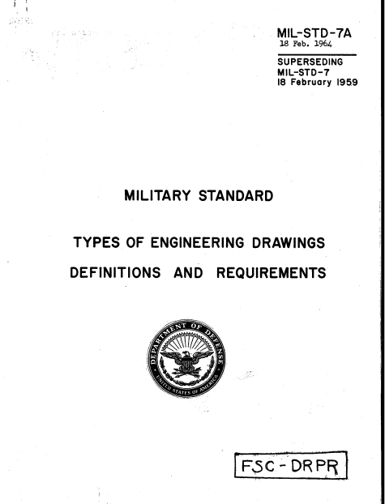
1990s to Present – Machine Display to Machine Readable
Notes:
In the mid-90s legislation and executive direction led to standards being provided as electronic documents.
Of course, initially, these were simply scans of printed documents. Low quality, and not editable. …that’s important, something that will come up again in Jesse’s part of the presentation
By the late 90s, we moved beyond the initial electronic scans of documents which were fine for machine display for human consumption, but were not suitable for machine readability, when word processors and pdf applications advanced to enable conversion between formats will little/no error.
Today, ASSIST provides web-based on-demand electronic access to users…but that access is still to electronic versions of static PDF documents
Essentially electronic paper-driven processes, that are human-intensive…requires a human to read, interpret, and then copy/paste, model, code, or otherwise manually re-enter

Slide 10
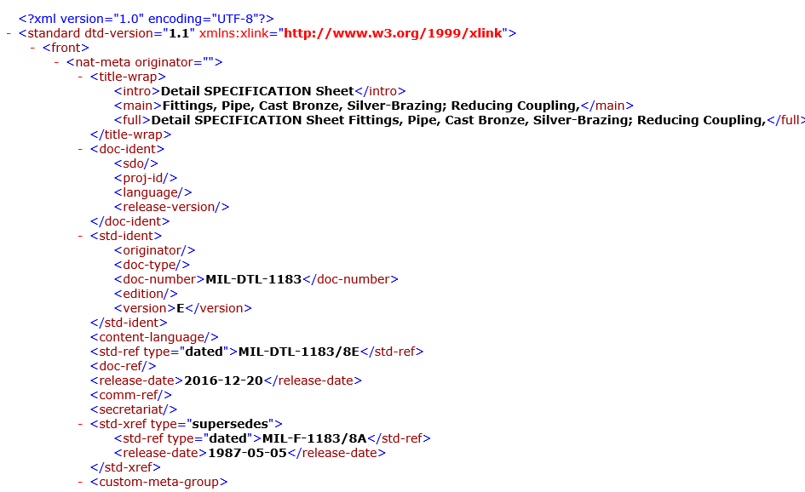
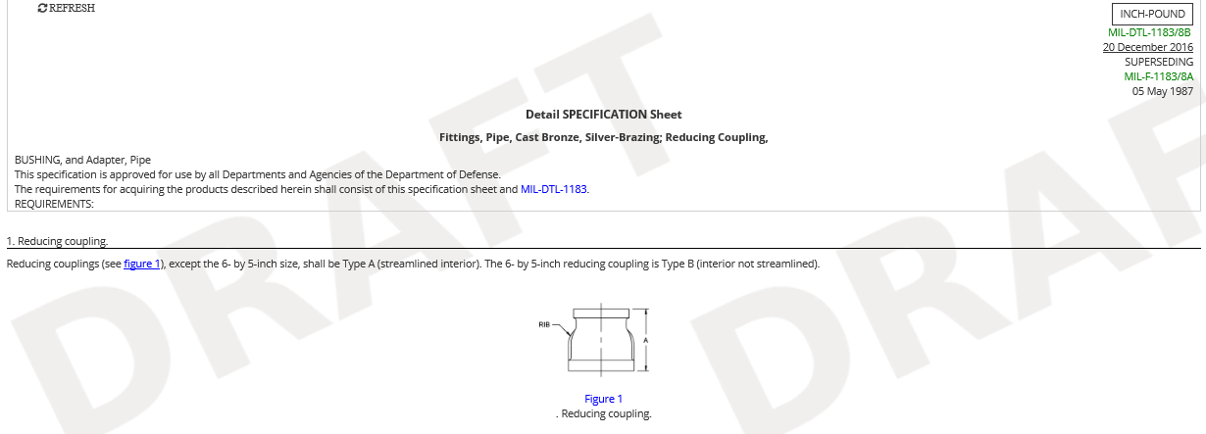
Today and Tomorrow – Machine Readable to Machine Understandable
Add XML pic
Notes:
While that hasn’t changed much in 20 years, that doesn’t mean that we haven’t been active.
While DX and DE efforts are creating digital tools/capabilities, thus a demand for standards as digital products,
the standards community has continued to experiment and explore digital publishing and related technologies
In the 2010s, we as a community (government and civil standards developers) explored other digital file types (XML, SGML, HTML)
And more recently, machine learning, natural language processing, and semantic web technologies are enabling machine-based understanding and semantic linking of the data elements and content within documents
At the same time, particularly within the engineering and manufacturing communities, 3D models and other digital system models ( 3D PDF, CAD, SysML) are becoming more prevalent for design and manufacturing. We are monitoring and partnering with DoD activities using these model-based files as well.
Today, though, we will focus on our first “baby step” of converting documents to XML
This step is the first step in providing or publishing “Documents as Digital Data” and is how we are moving beyond static PDF documents
----Skip, for time-----
in some circles, you may hear related efforts referred to as “smart standards” – essentially ways to publish documents as digital data in a way that supports interoperability, and machine readability
While there are alternatives out there (e.g., JSON), XML as our machine-readable format of choice. We don’t have the resources to be the leader or outpace our user-base. Documents as digital data begins with making documents machine readable and useable in document form, enabling both machine and human readability. XML does this for us.
However, I fully expect other formats, tools, and uses will be developed over time
As natural language processing, semantic web tools, and machine learning advance, they will provide the structure and semantic understanding necessary to further leverage machine understanding and machine processing of the content in standards

Slide 11
Agenda
Digital Engineering and the Digital Transformation
Documents as Digital Data
XML Conversion and Way Ahead
Notes:
At this point, Jesse will dive a bit deeper into our office’s XML conversion efforts and the challenges and lessons we’ve learned along the way…

Slide 12
What is the DSPO trying to do?
The DSPO objective is to use XML conversion software to convert Defense Standardization Program documents as digital data ensuring DSP documents are both human and machine readable in form.
Converting documents to XML will be a core building block in the overall transition to Digital Engineering and documents becoming more than simply storage.
Converting and publishing existing DSP documents in XML is a step towards providing digital standardization products useful in digital engineering and acquisition processes.
Notes:
In support of DOD transition to “Digital” or Digital Engineering historical DSP documents must be converted from PDF/Word into a machine readable format (XML).

Slide 13
XML Conversion: What Are We Trying to Do?
Project Stages/Phases:
  Evaluate/Pilot XML software to determine the best tool for converting existing documents to XML
  Convert existing/historical DSP documents into XML
  Publish new documents and revisions in XML
  Allow DSP document updates to be done in digital format
Notes:
Converting documents is but one baby step in making standards available as digital data…
The DSPO objective is to use XML conversion software to convert Defense Standardization Program documents as digital data ensuring DSP documents are both human and machine readable in form.
Converting documents to XML will be a core building block in the overall transition to Digital Engineering and documents becoming more than simply storage.
Converting and publishing existing DSP documents in XML is a step towards providing digital standardization products useful in digital engineering and acquisition processes.
To date the project has tested close to 250 DSP Specifications and Standards using the eXtyles software. In November of 2021, Inera will began work on a software conversion tool that will eliminate some of the pre-work users must complete on a document before converting. This should reduce user time spent editing a document.
Additionally we were given the opportunity to access the XSB Texspecs software in an effort to support improving the TexSpecs software through access of DSP documents on hand and allowing the DSP to evaluate TexSpecs as a prospective tool in converting DSP documents. Around 72 documents inspected.

Slide 14
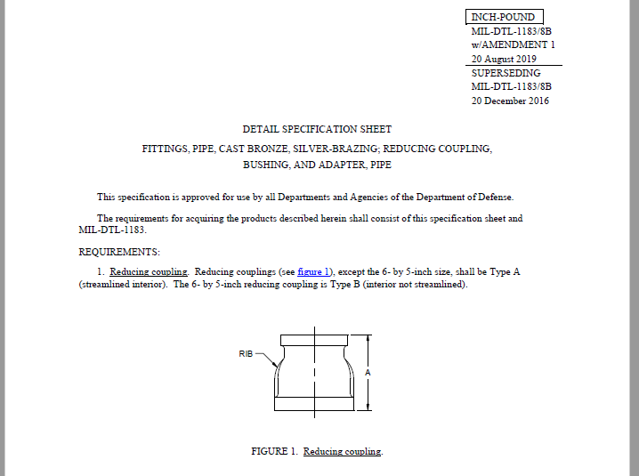
How is it done today?
Activities draft DSP documents in a variety of methods and this is left to their preference, but documents must meet the requirements of MIL-STD-961 and MIL-STD-962.
Documents are submitted via ASSIST and published as PDF files
Updates to the documents are also done in a variety of methods based on SMA preference.

Slide 15
What are the limits of current practice?
Documents are not machine-readable
Despite content/format standards, variability exists in document formatting
Some documents are not 508 compliant
Many legacy or older documents are no longer available in an editable format, resulting in a significant workload to rekey the documents when a revision is needed

Slide 16
What is new in your approach and why do you think it will be successful?
Piloting, and a phased approach will ensure success before taking the next step
Current XML conversion tools require documents to be uploaded onto the tool, where the document objects are recognized by the tool and converted in XML. To recognize the various DSP documentation formats, tools must be custom tailored so that once uploaded the tool recognizes the pertinent headings, sections, tables, charts, etc. This requires an understanding of the “traits” of a document format and how users fulfill document requirements
Prior to uploading a document onto the tool, the document must be edited in order for the tool to properly recognized sections, heading, etc.
Central management of tools and process for conversion to XML
  Eliminates burden of XML tool evaluation, cost, training, etc. for the SMAs
  Educates DSPO staff on XML and tool capabilities and limitations, in order to inform revisions to policy, procedures, and guiding standards
Notes:
1st bullet: Don’t want to jump right into to attempting to convert all DSP documents. Piloting allows for the tailoring of the software as issues are discovered during testing.
4th bullet: Point is for the DSPO to maintain the XML software removing the need for users to purchase additional software individually . Also through the XML Pilot, information will be gain to update DSPO policies to include Digital Documents format.

Slide 17
XML View of DSP Document

Slide 18
XML View of DSP Document

Slide 19
What difference will it make?
Project will benefit many different stakeholders including ASSIST users, SMA’s/document prepares, and DSPO/DSPAO.
  ASSIST users will receive updates to documents at faster speeds and also easily access linked documentation of documents
  SMAs will more easily be able to update documents under their cognizance, easily link document references, and be aware of outdated references within their documents
Updates to MIL-STD-961 and MIL-STD-962 will be necessary to include format requirements for XML files
    Page Numbers
    Table of Content
    Change markers
    Document Creation/Submission
    And more…

Slide 20
What are the risks?
Historical DSP documents are too complex in structure to be easily converted to XML causing an increase in price of tool to meet the unique needs
Time to convert DSP documents cannot be reduced further through software changes causing an increase in time to convert all historical documents
Conversion of documents depends too heavily on contractor support resulting in reoccurring fees to use the tool
Final documents converted are not accurate of the original document

Slide 21
How long will it take?
Final Evaluation of XML tools is expected to be completed between 2022 and end 2023.
Following tool selection, DSP historical DSP documents will be converted into XML where possible. A detailed review of DSP documents readable and those that are not will take place, with those being readable being converted.
By 2023, all new documents will be able to be converted to XML during initial submission.
Notes:
Final

Slide 22
What are the mid-term and final “exams” to check for success?
Mid-terms
  Update of DSPO MIL-STD--961 and MIL-STD-962 to include digital formats
  Successful conversion of all DSP document types
Final Exam
  All new documents uploaded into digital form-
    Enabling easier document updates and editing
    Ensuring long term archiving and storage of historical documents
    Allowing content to be more richly hyperlinked, both internally and externally
    Allowing content to be searchable

Slide 23
Q&A
Notes:
At a high level- our challenges are pacing our efforts to provide maximum value with our limited resources…we’re not driving digital engineering and we are not going to leap frog ahead and provide a more advanced product than can be used by the standards end-user.
Accept questions, and we are also interested hearing how you all are supporting digital engineering, digital transformation or documents as digital data. If we have time for brief feedback now, or a more thorough discussion in a subsequent meeting.

